Slide 1
Gamma Distribution
Prepared by
Sudip Pokhrel

Slide 2
Family of right skewed distribution
The variables of gamma distribution take only the positive values
The application of gamma distribution is to provide appropriate model for calculating probabilities concerning the length of life of industrial equipment, electrical supply in certain area, distribution of petrol etc.
This distribution is also applied to waiting time modules in life testing, waiting time until death etc.

Slide 3
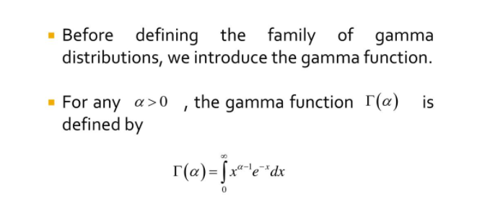
Gamma Function

Slide 4
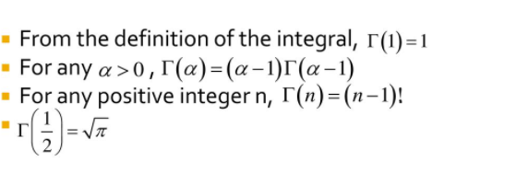
Important properties of gamma function

Slide 5
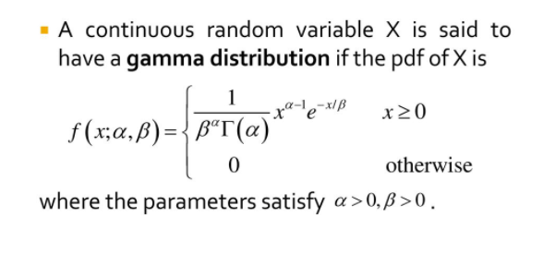
The Gamma Distribution

Slide 6
Properties of Gamma distribution
The parameter α is called shape parameter (determine the shape/skewness of distribution
The parameter β is called scale parameter (determine the width of the distribution)
It is highly skewed distribution (right skewed distribution)

Slide 7
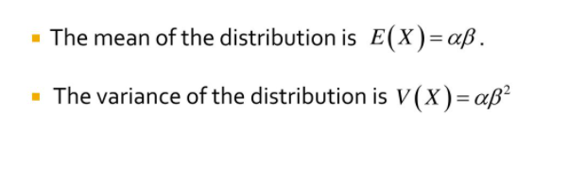
Mean and Variance of Gamma distribution

Slide 8
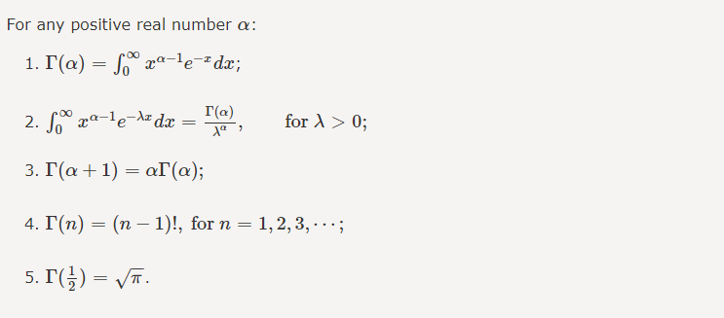
Some other properties

Slide 9
Numerical
Q1. In a city, the daily consumption of electric power (in million of kilowatts- hours) can be treated as a random variable having gamma distribution with shape parameter 3 and scale parameter 2. If the power of plant of city has daily capacity of 12 million kilowatt-hours, what is the probability that this power supply will be inadequate on any given day?
Q2. In a certain city the consumption of water (in millions of gallon) follows approximately gamma distribution with α= 2 and β= 3. If the daily capacity of this city is 9 million gallons of water, show that the probability that on any given day the water supply is inadequate is 4e^-3

Slide 10
Q3. Suppose that the survival time X in weeks of a randomly selected male mouse exposed to 240 rads of gamma distribution with α= 2 and β= 15. a) Find the expected time and standard deviation b) find the probability that a mouse survives between 10 to 30 weeks.

Slide 11
Chi Square Distribution
It has single parameter denoted by V
It is always positively skewed for small degree of freedom and symmetric for large degree of freedom
The total area under the each curve of chi square distribution is 1 or 100%
It is the special case of gamma distribution

Slide 12
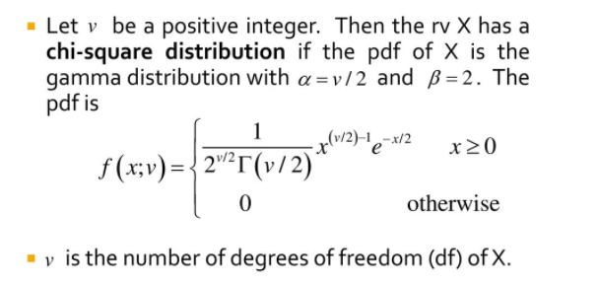
Definition

Slide 13
Application
This test can be used in
Test of goodness of fit
Test of independence of attribute
Test of homogeneity

